Slide 1

BIG MOUNTAIN RESORT
PRESENTATION
AND
FINDINGS

Slide 2



PROBLEM IDENTIFICATION
Big Mountain Resort is undercharging for its facilities and features and desires to increase admission ticket prices to cover operational costs and be priced more accurately while remaining competitive in market value. New and additional costs to draw and retain customers also necessitate the demand for a ticket price increase.

Slide 3
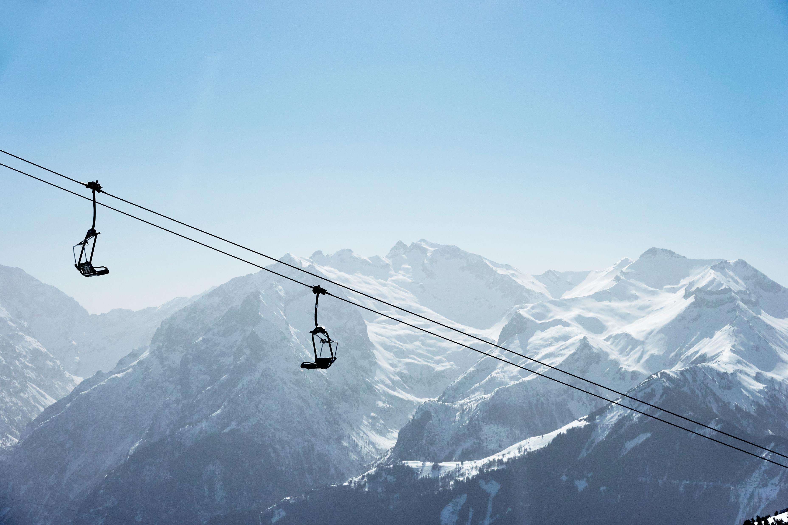
RECOMMENDATION AND KEY FINDINGS
Montana resorts including BMR show little variability in ticket price whereas Adult Weekend prices are generally more expensive in other states. BMR could capitalize on the weekend surge in customers as well.
Some key findings of note are certain features that are prominent and major influential factors in ticket price such as snow-making and resort-night-skiing state ratio. Total chairs is also a more influential feature which correlates with the amount of runs a resort contains. A key realization to keep in mind is that other resorts may have mispriced themselves too.

Slide 4
MODELING RESULTS AND ANALYSIS
count %
fastEight 166 50.303030
NightSkiing_ac 143 43.333333
AdultWeekday 54 16.363636
AdultWeekend 51 15.454545
As illustrated by the data frame on the left, about 16% of resorts are missing ticket price values but some have one price target available while lacking the other price target having either AdultWeekday but not AdultWeekend and vice versa.

Slide 5
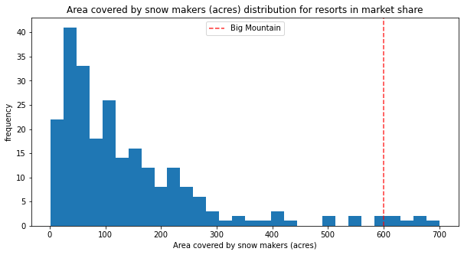
MODELING RESULTS AND ANALYSIS
Big Mountain ranks highly in many features offered at resorts including high number of total chairs, high number of fast quads, one of the largest skiable terrains, and as seen on the left on the histogram, one of the largest areas covered by snow makers. BMR is positioned advantageously in finding support for a price increase and the training model shows BMR is undercharging and can raise the price to cover additional costs.

Slide 6
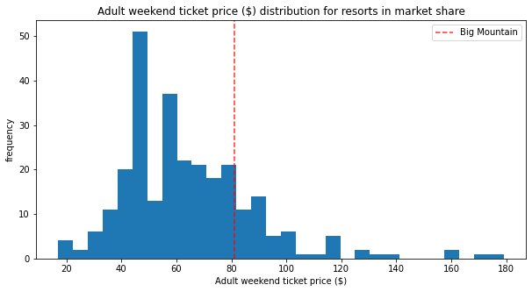
MODELING RESULTS AND ANALYSIS
Big Mountain Resort’s modeled price ended up higher than its current price due to BMR originally undercharging for its facilities and features. Deficiencies in the data were potentially there as far as accurate data for the other resorts as if BMR’s ticket price needed to be adjusted accordingly, then perhaps some other resorts ticket prices were skewed either leaning toward being too cheap or too expensive relative to their features. A histogram of ticket prices for resorts across states is provided in the left for reference.

Slide 7
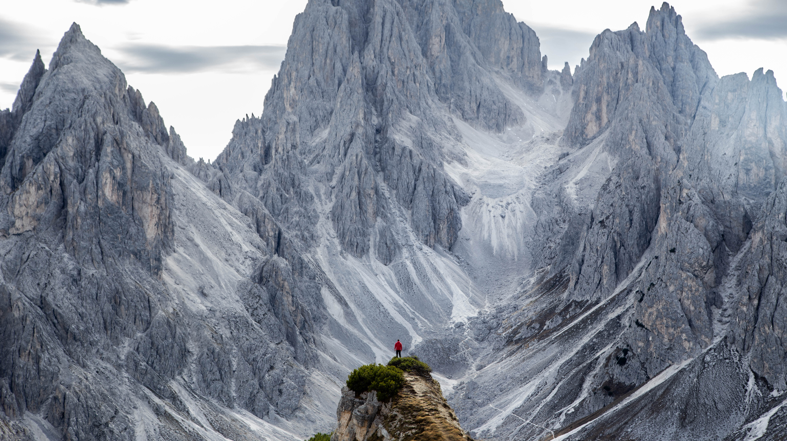
SUMMARY AND CONCLUSION
An opportunity presents itself for Big Mountain Resort to adjust its ticket price to be valued accurately and thus generate more revenue to cover operational costs by capitalizing on its highly desired features and facilities that draw in visitors to its resort. The ticket price increase may serve to both meet BMR’s costs and increase surplus while also catering to loyal and new visitors alike.

